Slide 1
The Hungarian Partner’s Progress
PRO-ME-TOM

Slide 2
General preparations
Translation and sending of invitation letters ✓
Translated and sent the Invitation Letter to the Ministry of Interiors (which includes the area of Education, too) [The State Secretary of the field of Education sent a welcome letter in response.]
and also to the Office of Education (Pedagogical Institute).
Press release: we also announced the start of the project in the Faculty newsletter of the University of Pécs.
Ethical approval in Hungary is not necessary for a project like this. From 2023 on, though, each university had to set up an ethics committee, which can provide ethical permissions. We plan to apply for one in the near future for the upcoming parts of the project.

Slide 3
Project/research assistant
Right at the beginning we recruited project assistant, András Hegedüs
Task:
Keep contact with the participating teachers
Copy and send the test sheets to the teachers
Assist during the training
Upload materials in Google Drive
Entry research data in database

Slide 4
The process of the invitation of teachers
We formulated and invitation letter to the school leaders of the University’s Partner Schools announcing the start of the project and invite teachers to participate.
Partner schools are scattered all over Hungary, so the invitation could reach the majority of Hungarian teachers.
We also formulated an invitation letter directly for the teachers (which was attached to the letter for the headmasters) and created a Google form for the application.
For this first invitation 38 teachers answered.

Slide 5
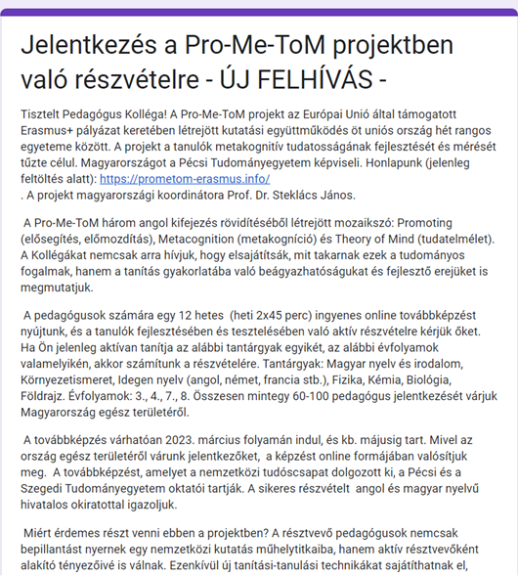
Second invitation
After the decision at Pécs meeting to broaden the circle of invited teachers we formulated a new invitation letter to the school leaders as well as to the teachers and created a new Google form for application.
For the second invitation 45 teachers answered. (Some of the applicants did not meet the criteria of participation. They were invited for the training as visitors.)
So, we started the teachers’ training with about 70 teachers.

Slide 6
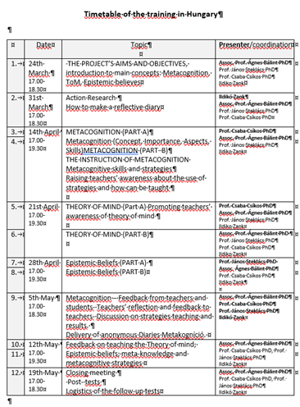
Preparation for the training
Invitation of the presenters ✓
Ildikó Zank, assistant professor at PTE – on Action research and reflective diaries
Csaba Csíkos, professor at SZTE – on Metacognition, on some research findings in ToM
Ágnes Bálint, associate professor at PTE – on basic concepts of metacognition and ToM; on the educational relevance of ToM research
János Steklács, professor at PTE – on Epistemic believes and their educational relevance.
Development of the schedule of teachers’ training ✓

Slide 7
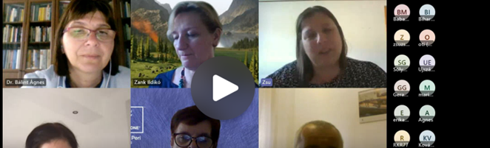
The training
Training sessions when it was possible were merged so instead of 12 occasions we had 8,
approximately spending 24 hours together.
The trainings went online on Teams platform.
Each training session ended with a presentation summarizing the upcoming tasks and tests, including the necessary links to online tests and the following training session. Teachers could ask questions and we answered them, too.

Slide 8
The tests
In the meantime, the test battery was finalized, and the translation of the tests began.
We also created a Google Form version to each test.
Teachers participating were asked to fill the tests only in online form, but for students it was possible to choose either the paper or the online version of each test. Ultimately it was their teacher’s decision which version a group of students used. It depended on the ICT infrastructure of the school as well as on the teacher’s preference.
Those who chose the paper version were sent the proper number of test papers via post and at the end of the training they sent the filled in tests back via post or in a scanned form via email. All the others worked with the online tests.

Slide 9
Reflective diaries
Teachers were encouraged to write a reflective diary during the intervention period.
Eventually 13 diaries were uploaded in the associated Google Form.

Slide 10
Contact with the teachers
Contact with the teachers was constant through emails.
We created the prometompecs@gmail.com address where teachers could contact us and we could send them additional materials or further news.
We also had a Google Drive where all the teaching materials and the electronic version of the individual test as well as the recorded presentations were uploaded
András Hegedüs was responsible for the contact with the teachers, uploading the materials for the Google Drive

Slide 11
Training done✓
Plenty of filled tests ✓
Intervention done ✓
The aims of the project were not completely fulfilled in some aspects:
The period of time for the whole training and the intervention was too short (we started in the middle of March, had a week break at Easter and needed to finish by May because of the near end of the schoolyear)
Pre-testing – we had no time
‘Activities’ to be shared: Only a few teachers shared some, from which 2 activities were found relevant to the project.
Post testing: Only some of the teachers did it.

Slide 12
Problem: high drop-out rate
About 30 teachers withdrew due to various reasons:
some had emerging family problems which became their priority
many were overloaded with work and gave up
some had to leave for weeks due to different reasons (e.g. school excursion, travel abroad, etc.) and finally they gave up
some found it very difficult to do all the tests and tasks expected (besides their workloads) so they quitted
for some unknown reasons they did not show up after a while.

Slide 13
The background of the high dropout rate
Teachers in Hungary have been overloaded and underpaid.
Before and during the period of the training there were harsh teachers’ protests all over Hungary and many teachers left (or were forced to leave) their profession.
The high inflation of the prices resulted in the devaluation of already low salaries.
The government’s communication was offensive with the protesting teachers.
In this situation we could feel lucky to have even a handful of teachers who were willing to involve in a training which entailed extra workload for no payment.

Slide 14
Risk management
Risk management
we shared all the information at hand with the participating teachers to keep the whole process transparent for them
we offered constant contact via email to discuss difficulties, to ask for help or information
we provided unlimited access to all materials via Google Drive
we offered individual ways to complete the training and the tasks (via recorded presentations that could be accessed any time, or rescheduled some tests and activities for those who needed and let the teachers complete them a week later than the others did)
we tried our best to provide a safe and warm atmosphere for the participants sharing their reflections and difficulties
we encouraged the participants to feel part of a community where they can share information and thoughts
we encouraged their awareness of being active participants of an international research project aiming to develop students’ metacognitive skills
in the second invitation letter we offered a small gift for the participation at the end

Slide 15
Certificates
Only 19 of the remaining teachers completed more or less the whole set of tasks and 21 others participated till the end of the project and did their best but left some tasks unfinished.
Altogether 40 teachers got a certificate on their participation of the training.

Slide 16
The aim of the training was only partly fulfilled.
It is necessary to repeat the training in Hungary with a set of new teachers to meet the optimal number of participants and eventually get enough data from the tests.

