Slide 1
PRO-ME-ToM - Greece Project Coordinators
Panagiota Metallidou
Aristotle University of Thessaloniki, Greece
Plousia Misailidi
University of Ioannina, Greece
University of Ioannina

Slide 3
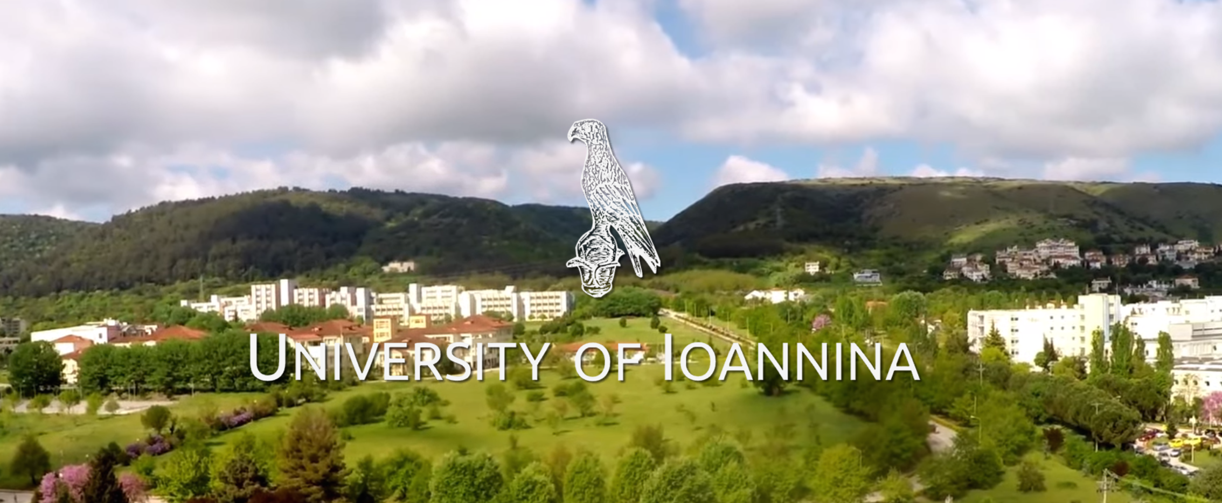

Slide 4
Activities that have been completed between September 2022 - September 2023

Slide 5
A. Preparation of the PRO-ME-ToM’s Tools University of Ioannina & Aristotle University of Thessaloniki
Participating in meetings from September 2022 till February 2023 aiming at the selection or adaptation of tools to be used in the intervention.
Developed or adapted tools for assessing teachers’ and students’ Metacognition and Theory of Mind.
Translated the new tools in English/Greek
Prepared scoring directions
Pilot testing part of the tools

Slide 6
A.1 Preparation of Teacher - Tools
Aristotle University of Thessaloniki
Developed one self-report questionnaire assessing:
teachers’ beliefs about the usefulness of various learning strategies and teaching practices aiming to enhance students’ metacognitive knowledge and skills. (Translated in English for the partners)
Selected a second self-report questionnaire -from the ones available in the literature- to assess teachers’ metacognitive awareness about themselves as teachers (Metacognitive Awareness Inventory for Teachers (MAIT) Balcikanli, 2011, adapted and validated in 617 Greek teachers by Koulianou et al, 2021).
Prepared the scoring directions for both questionnaires.
Tested both questionnaires in a sample of 151 Greek teachers (72 from primary and 79 from secondary education).

Slide 7
A.1 Preparation of Teacher - Tools
University of Ioannina
Developed two questionnaires assessing:
teachers’ awareness of their students’ theory of mind skills.
teachers’ everyday teaching practices aiming to enhance students’ ToM skills
Selected and adapted a third questionnaire -from the ones available in the literature- to assess teachers’ understanding of students’ theory of mind.
Prepared the scoring directions for all three questionnaires.
Translated all three questionnaires in Greek [for use by the Greek and Cypriot partners].

Slide 8
A.2 Preparation of Student - Tools
Aristotle University of Thessaloniki
Developed and adapted a battery of tasks to assess students’ metacognitive knowledge and skills (for the pre, post and the follow up phase of the intervention) [to be used by all partners]
Metacognition tasks are targeting children’s:
Awareness of their difficulties while studying Language or/and Physics in school and home (a 14 items self-report questionnaire)
Metacognitive monitoring skills (6 fictional stories which contained errors to be detected, 4 for the primary and 2 for the secondary students)
Prepared the scoring criteria to be used by all PRO-ME-ToM partners to score students’ responses in the tasks
Translated all student measures in English [to be used by all PRO-ME-ToM partners]
Pilot tested part of the tools in one class of secondary students

Slide 9
A.2 Preparation of Student - Tools
University of Ioannina
Selected and adapted a battery of three tasks to assess students’ “theory of mind” (for the pre, post and the follow up phase of the intervention). [to be used by all partners]
Theory of mind tasks are targeting children’s:
understanding of the intentions and beliefs underlying different figures of speech (six stories)
third-order order false belief understanding (two stories)
children’s ability to recognize complex mental and emotional states based on photographs’ of people’s eyes (picture task).
Prepared the scoring criteria to be used by all PRO-ME-ToM partners to score child participants’ responses in all theory of mind tasks
Translated all child measures in Greek [to be used by the Greek and Cypriot partners]
Pilot tested part of the tools in one class of secondary students

Slide 10
A.3 Questionnaires - Google form preparation
University of Ioannina & Aristotle University of Thessaloniki
Teacher tools were completed online.
UoI and AUTH prepared the Greek version of the online google forms presenting the teacher questionnaires [to be used by the Greek and Cypriot partners] and the evaluation of the program questions.

Slide 11
B. Preparation of the PRO-ME-ToM’s Intervention Program
University of Ioannina & Aristotle University of Thessaloniki
Prepared part of the contents of the intervention focusing on metacognition and ToM [to be used by all partners]
Prepared activities that were used by teachers in their classrooms, in order to boost students’ metacognitive knowledge, monitoring and ToM skills [to be used by all partners]
Translated all the above in English/Greek

Slide 12
C. Implementation of the Intervention

Slide 13
C.1 Before the Implementation – Ethics Committees Applications
Aristotle University of Thessaloniki
Preparation of the application for research ethical approval to the:
Ethics Committee of the Aristotle University of Thessaloniki [granted]
Ethics Committee of the Greek Ministry of Education [granted]
University of Ioannina
Preparation of the application for research ethical approval to the:
Ethics Committee of the University of Ioannina [granted]
Ethics Committee of the Department of Primary of Education of the University of Ioannina [granted]

Slide 14
C.1 Before the Implementation – Open call – Invitation for teachers to participate in the program
Aristotle University of Thessaloniki & University of Ioannina
Prepared and distributed an open-call invitation for teachers working in areas of Macedonia and Epirus and the rest of Greece [in Greek].
Had contacts with the:
Greek Ministry of Education
Epirus Regional Directorate of Primary and Secondary Education, Greece
Prepared and distributed parent and teacher declaration of consent forms [in Greek].
The open-call invitation was distributed to teachers via the:
Epirus Regional Directorate of Primary and Secondary Education, Greece
Announcement in the webpage of the Laboratory of Educational Psychology, Counseling & Research
Announcement in the webpage of the Open University of Greece
Announcement in the webpage of the School of Psychology, A.U.T.H.
Personal emails to teachers and school directors that were sent with the help of the Aristotle of Thessaloniki and the University of Ioannina Professors
Social media platforms

Slide 15
Teacher Participants in the Greek Intervention program
In total, seventy (70) teachers and their students participated in the Greek program:
thirty (28-30) teachers collaborated with the Aristotle University of Thessaloniki and
forty (40) teachers collaborated with the University of Ioannina
completed the “before” and “after” teacher questionnaires, implemented the intervention program in their classrooms and collected data from their students before as well as after the completion of the program.
> 10 teacher participants participated in the training but did not contribute full student data (pre and post) and for this reason will not be counted in the final Greek sample.
2 control classes (1 from primary and 1 from secondary school)

Slide 16
C.2 During the implementation
Aristotle University of Thessaloniki & University of Ioannina
P. Metallidou and P. Misailidi participated in >10 of the twelve 120-minute sessions of the intervention program.
Communicated systematically with teachers giving them feedback and helping them to adapt the activities that were to be implemented as well as to design new activities.

Slide 17
C.3 After the implementation
Aristotle University of Thessaloniki & University of Ioannina
Collected the questionnaires/tasks that have been completed by students in participating schools during the pre- and post- measurement phases of the program.
Collected the proposed activities prepared by some of the teachers’ during and after the intervention.
Sent certificates confirming teachers’ participation in the PRO-ME-ToM project.
Communicated with teachers informing them about the last (follow-up) phase of the PRO-ME-ToM.

Slide 18
D. Other Activities with the project’s partners
PRO-ME-ToM’s Website Development
Preparation of the first PRO-ME-ToM paper
Preparation of a Conference presentation
Participation with presentations in partner meetings

Slide 19
D.1 PRO-ME-ToM’s Website Development
University of Ioannina
Participated in the development of the PRO-ME-ToM’s website:
Prepared and proposed the structure of the website
Organized and participated in meetings with I. Zsigmond and E. Papaleontiou-Louca focusing in the design of the website
Collected material by partners and forwarded them to I. Zsigmond to be uploaded to the PRO-ME-ToM website
Collected bibliographic material on theory of mind to be uploaded to the PRO-ME-ToM website

Slide 20
D.2 Preparation of the first PRO-ME-ToM paper
Preparation with colleagues/partners from Cyprus an article which will focus on the rationale and the content of the teachers’ training program.
PROMOTING THE DEVELOPMENT OF TEACHERS’ AND STUDENTS’ METACOGNITIVE AND THEORY OF MIND (ToM) SKILLS: A PROPOSAL FOR TEACHERS’ TRAINING
Abstract
PRO-ME-ToM is an Erasmus+ collaborative project with researchers from five European countries (Cyprus, Greece, Hungary, Portugal and Romania). The aim of this research project is to promote primary and secondary teachers’ and students’ metacognitive, epistemic and Theory of Mind (ToM) knowledge and skills. Participants will be teachers and students from five (5) countries (Cyprus, Greece, Hungary, Portugal, and Romania). Initially, a three-month intervention (12 training sessions) will take place with teachers, aiming, firstly, to promote teachers’ awareness of strategies and practices that can enhance students’ metacognitive, epistemic thinking and ΤοΜ skills and, secondly, to implement these practices in their everyday teaching practice by adopting the principles of action research. A number of measures (scales and tasks) will be administered before the beginning and at the completion of the intervention to assess teachers’ and students’ awareness and skills. This intervention is expected to lead to the creation of educational resources, materials and tools for the promotion of metacognition, epistemic thinking and ToM in primary and secondary education that will be available for use by teachers and students in the European Union and worldwide. This paper focuses specifically on the rationale and the content of the teachers’ training program. The outline of the 12 training sessions is described and examples of the activities that will be presented to teachers are discussed.

Slide 21
D.3 Preparation of a Conference presentation
Participation with on oral presentation in a Symposium in the 6th Panellenic Conference of Cognitive Science, 21-24 September 2023, Xylokastro Korinthias, Greece
Intervention program for the promotion of epistemic thinking, and metacognitive and theory of mind skills in primary and secondary education teachers
(Πρόγραμμα προαγωγής της επιστημικής σκέψης, των μεταγνωστικών δεξιοτήτων και των δεξιοτήτων θεωρίας του νου σε εν ενεργεία εκπαιδευτικούς πρωτοβάθμιας και δευτεροβάθμιας εκπαίδευσης)
Παναγιώτα Μεταλλίδου¹, Πλουσία Μισαηλίδη², Ελεονώρα Παπαλεοντίου-Λουκά³, Μαρία Κουτσελίνη⁴ και Καλυψώ Ιορδάνου⁵
¹Αριστοτέλειο Πανεπιστήμιο Θεσσαλονίκης, ²Πανεπιστήμιο Ιωαννίνων, ³European University of Cyprus, ⁴University of Cyprus, ⁵University of Central Lancashire Cyprus
In cooperation with: University of Coimbra, Portugal; University of Pecs, Hungary; Sapientia Hungarian University of Transylvania, Romania.

Slide 22
D.4 Presentations in Partner - Meetings
During the kick off Meeting in Cyprus (14 October 2022)
P. Metallidou – Aristotle University of Thessaloniki
Presentation of the proposed tools for teachers and students
P. Misailidi - University of Ioannina
Sent an outline of the activities and tasks completed by the UoI

Slide 23
D.4 Presentations in Partner - Meetings
During the Hungary Partner-meeting (23-24 February 2022):
P. Metallidou – Aristotle University of Thessaloniki
Made a 30-minute presentation about:
the rationale of the intervention program as regards metacognition
why teaching metacognitive monitoring and strategic thinking is important, and the challenges for teachers
ways of raising students’ monitoring and control skills as well as activities that were to be implemented during the intervention
P. Misailidi - University of Ioannina
Made a 20-minute presentation about:
the Theory of Mind construct and its development in childhood
the aims of the PRO-ME-ToM with regard to theory of mind and
the theory of mind tools (teacher and student) as well as the activities that were to be implemented during the intervention

Slide 24
Next steps
Follow up data from students (November 2023)
Data entry in the Excel and SPSS (December 2023)
Add data from control groups
Preparation of articles
Preparation of the scientific meeting with partners’ and teachers’ participation in Thessaloniki (May 2024)

Slide 25
Thank you for your attendance!

