Slide 1
3rd Pro-Me-ToM Erasmus Project Meeting
Lisbon, Portugal: 4 & 5 September, 2023
Dr Eleonora Papaleontiou - Louca

Slide 2
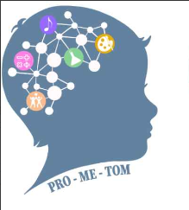
P
Pro-Me-ToM Project
Core Action 2 of the Erasmus+ Program
"PROMOTING THE DEVELOPMENT OF TEACHERS' AND STUDENTS' METACOGNITIVE AND THEORY OF MIND SKILLS“
(application code number: 2022-1- CY01-KA220-SCH-000088168)
4 & 5 of September 2022 - August 2024

Slide 3
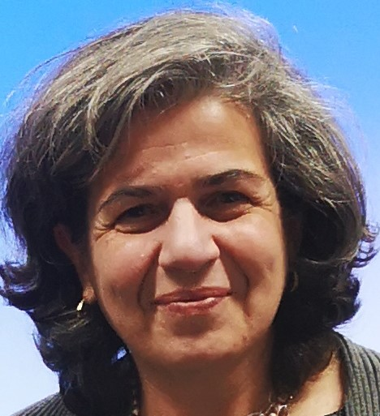
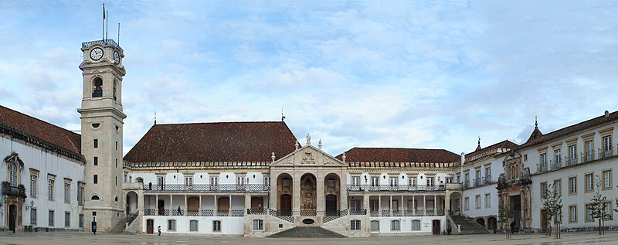
P
Pro-Me-ToM Project
Third Pro-Me-ToM Transnational Meeting
:
4 & 5 September 2023
THANKS TO THE UNIVERSITY OF COIMBRA and Maria de PIEDADE!

Slide 4
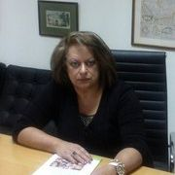
Pro-Me-ToM Project
What has been done so far (a)
Approval by: a. the Ministry of Education
b. the Pedagogical Institute and c. the Bioethics Committee
The project logo was designed and 2 websites were built
(one in Greek & one in English).
Press - Announcement was made
Radio Broadcast presentation on the value of Metacognition
and Invitation to the Program (with prof. Koutselini)
Invitation for teachers’ participation (Google forms on the Program’s
Website on social media) / Teachers’ Recruitment -less than expected
The Purpose and Objectives of the project have been translated into 4 languages ​​and have been uploaded on the official webpage.

Slide 5
P
Pro-Me-ToM Project
What has been accomplished so far (b)
Sections on 'Metacognition' and 'Theory of Mind' (Their Meaning and Importance) have been posted on our websites.
Pilot-testing of our Tools to Primary -school students to identify difficulties and misconceptions
Modification and Finalization of the Tools based on the above observations.
Preparation of our 1st article on our Intervention Program (almost ready) titled “Promoting Teachers’ and Students’ Metacognitive, Epistemic and ToM skills“
Metacognition - Theory-of –Mind - Epistemic Beliefs’ Assessment Tools have been developed, (for primary – and secondary school students) - translated in 4 languages and applied in 3 countries.
Recruitment of teachers (of Language & Science) at each country
An Intervention Program of 12 meetings was prepared, translated and applied in 3 countries (Greece and Cyprus together)

Slide 6
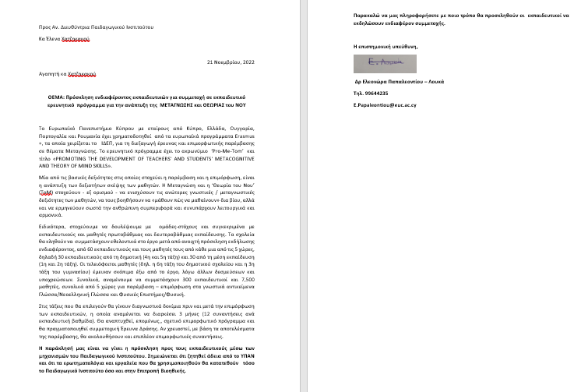
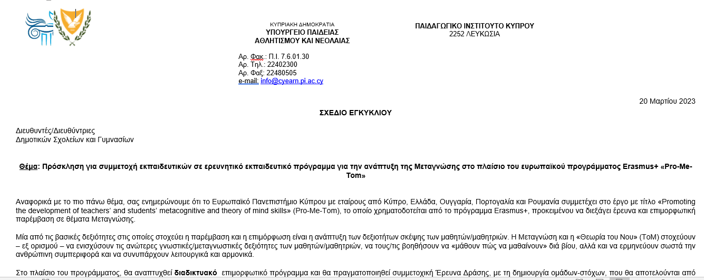
Pro-Me-ToM Project
LETTER TO THE
PEDAGOGICAL INSTITUTE
TEACHERS’ ΙNVITATION
BY THE MINISTRY OF EDUCATION

Slide 7
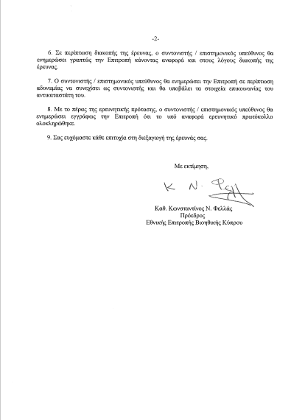
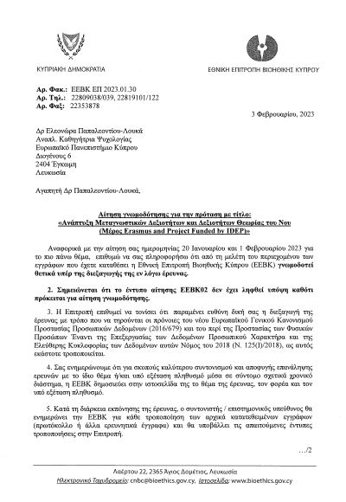
Pro-Me-ToM Project
Approval by the Bioethics Committee

Slide 8
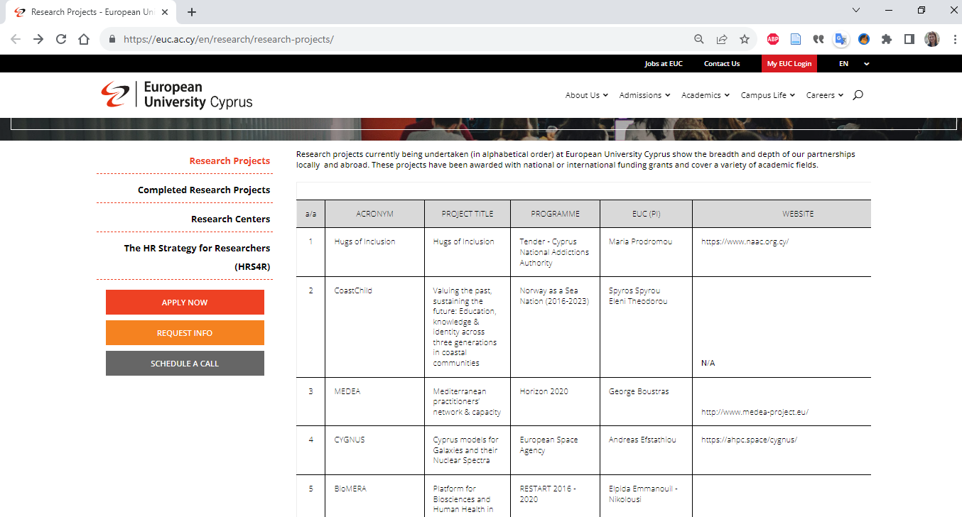
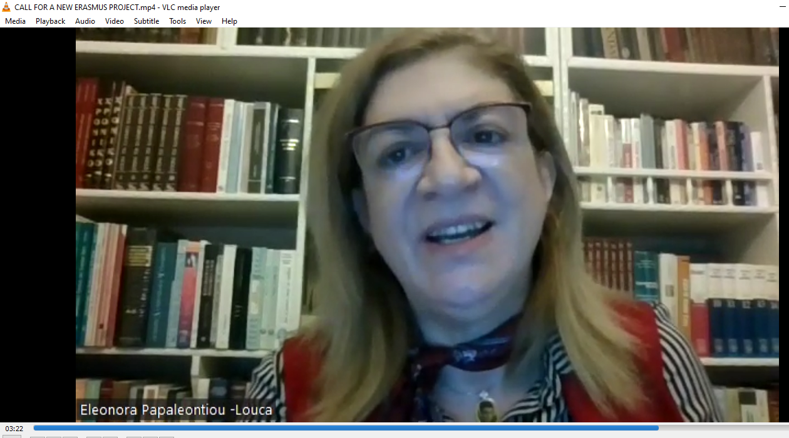
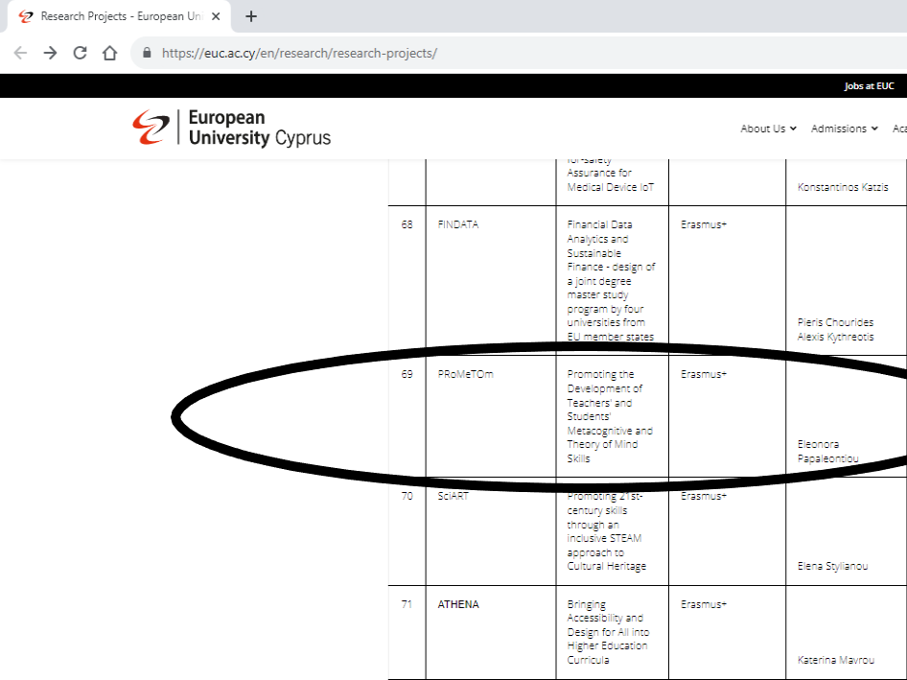
Pro-Me-ToM Project
ON-LINE CALL and EUC WEBPAGE
CALL FOR Α NEW ERASMUS PROJECT.mp4

Slide 9
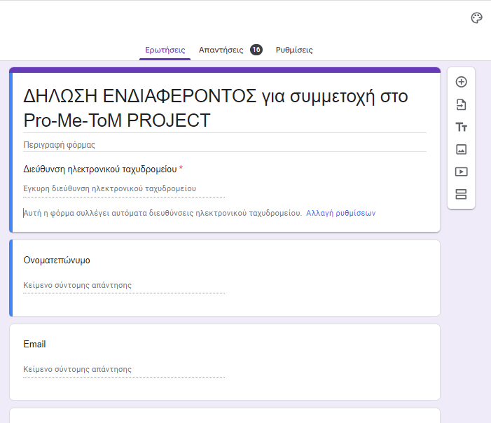
GOOGLE FORM INVITATION
https://docs.google.com/forms/d/1OrCGISBfGcEQF2ujI2mLKc6G8eHsRwDhgWIybOz1cY4/edit?fbclid=IwAR3IBDiUb7NnRygA11UoB8D5Nv59LgNYrHdDvQTWZs-wheMVsCwB8_bA9u0
Pro-Me-ToM Project
CRITERIA FOR PARTICIPATION IN THE PROGRAMME:
A) BE A PRIMARY OR SECONDARY SCHOOL TEACHER
TEACHING LANGUAGE OR SCIENCES
TEACHINGIN at the 4th or 5th grade of primary school
or
the 1st or 2nd grade of secondary school.

Slide 10
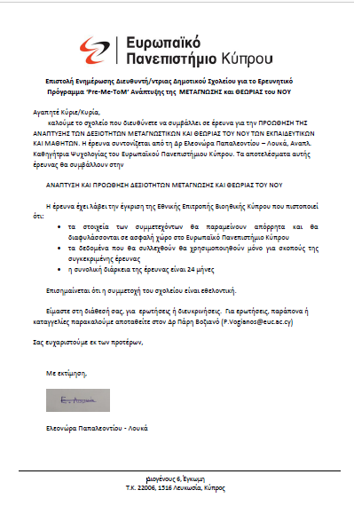
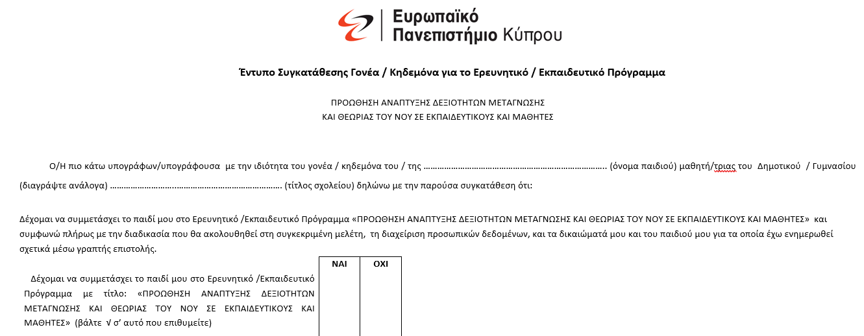
Pro-Me-ToM Project
LETTER TO TEACHERS/SCHOOLS
PARENTS’ ACCEPTANCE LETTER

Slide 11
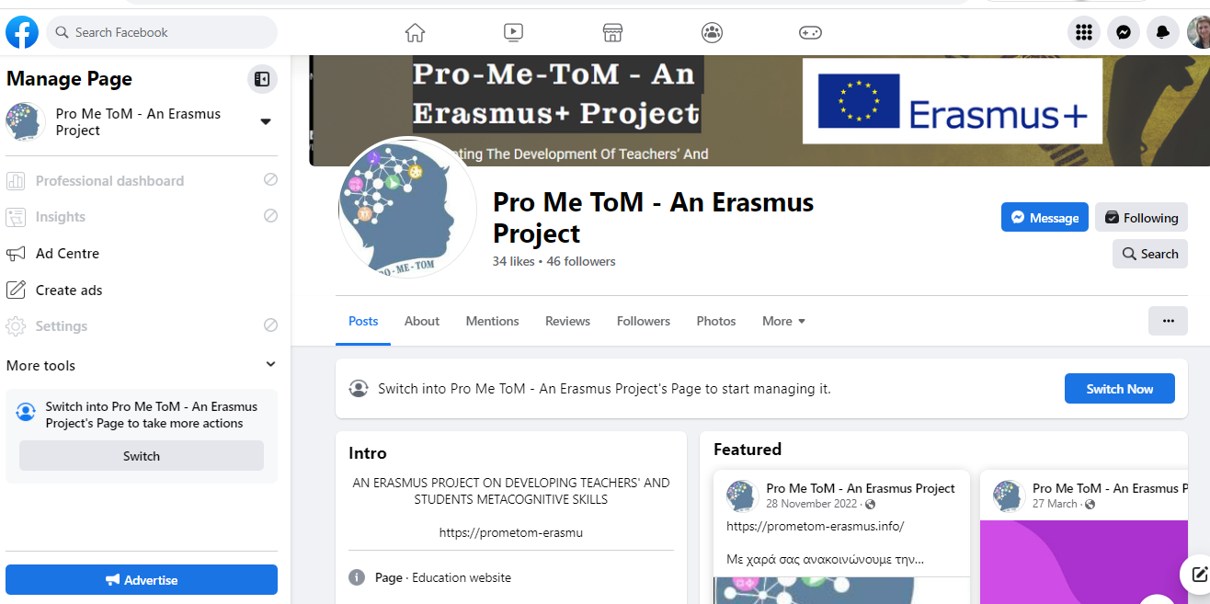
Pro-Me-ToM Project
Project’s Webpages: International and Greek
Official website Local/Greek Facebook Page
(coordinated by Istvan and Sira)
https://prometom-erasmus.info https://www.facebook.com/profile.php?id=100088059138891
The Project’s email addresses:
office@prometom.erasmus.info

Slide 12
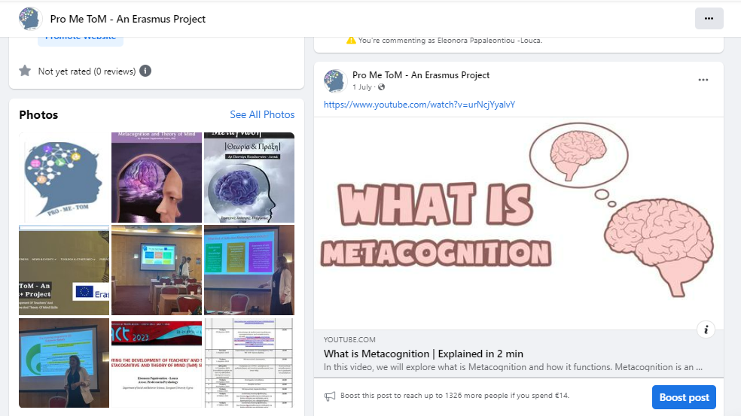
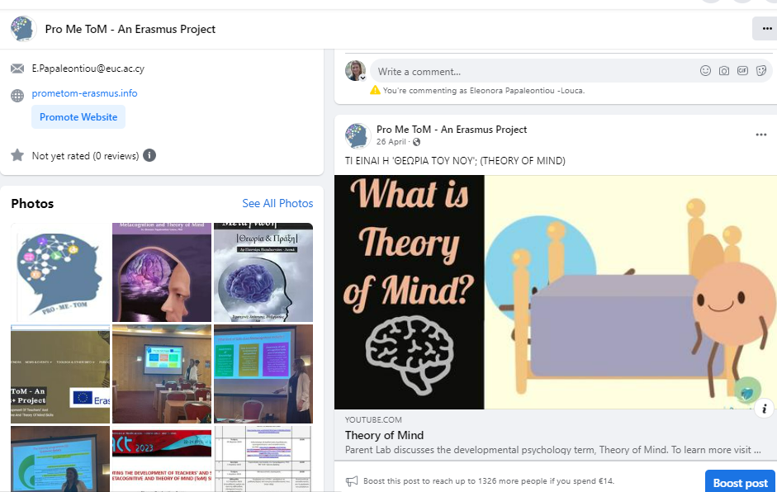
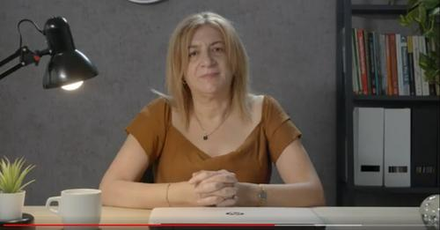
Η δασκάλα/ καθηγήτρια σάς έχε
VIDEOS, BOOKS, etc.
on our webpage
What does Metacognition mean
and which is its importance in Education?
https://www.youtube.com/watch?v=GzTgPUbEUhU&t=11s
Pro-Me-ToM Project
What is Theory of Mind?

Slide 13
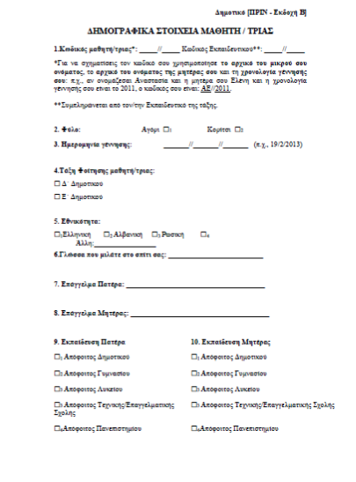
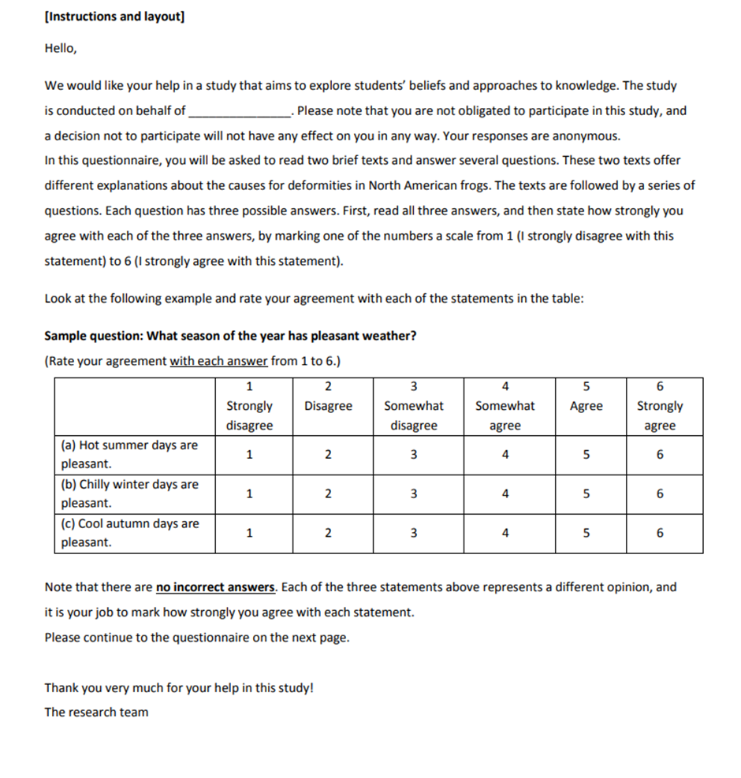
Pro-Me-ToM Project
PRE- and POST-TESTS
FOR TEACHERS AND STUDENTS
SAMPLE TEST FOR STUDENTS
SAMPLE TEST FOR TEACHERS

Slide 14
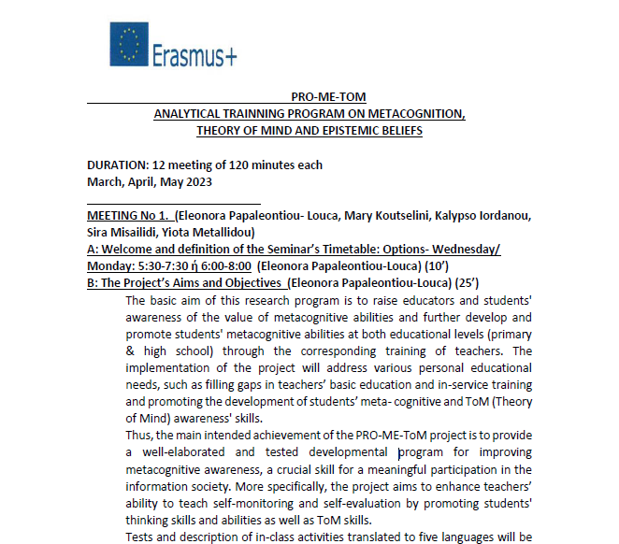
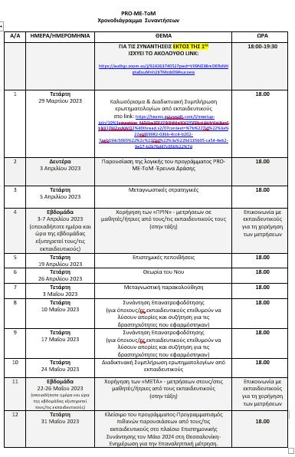
Pro-Me-ToM Project
Schedule of Meetings
of the Greek Intervention
Analytical Program Developed

Slide 15
Pro-Me-ToM Project
DESIGN OF ANALYTICAL TRAINNING PROGRAM
ON METACOGNITION,
THEORY OF MIND AND EPISTEMIC BELIEFS
DURATION: 12 meeting of about 100 minutes each
March –April - May 2023
MANY THANKS TO THE PROFESSORS:
Mary Koutselini- Yiota Metallidou – Sira Misailidi - Kalypso Iordanou

Slide 16
Pro-Me-ToM Project
Axes of our Intervention Program (A)
PURPOSE AND OBJECTIVES OF THE RESEARCH PROGRAM
1. Explanation of the Purpose of the Intervention:
a) To promote teachers and students’ awareness
about Metacognition, Theory of Mind and Epistemic Beliefs
and how these affect the development of students
b) The development of the ability to teach metacognitive strategies,
skills and cultivating critical thinking.
2. What is ‘Metacognition’ and how it can be developed.
3. Analysis of the Concept and Importance of Metacognition –
Developing Metacognitive Skills and Strategies
4. What is Theory of Mind and how it can be developed.

Slide 17
Pro-Me-ToM Project
Axes of our Intervention Program (B)
5. What are the Epistemic Beliefs and how can they be
developed?
6. Action Research – Its Concept - Value and Methodology as
a Participatory and Inductive Professional Development
Process
7. Educational Applications and Practical Examples for the Development of Metacognitive Skills, ToM Skills and Epistemic Beliefs in Students and Teachers

Slide 18
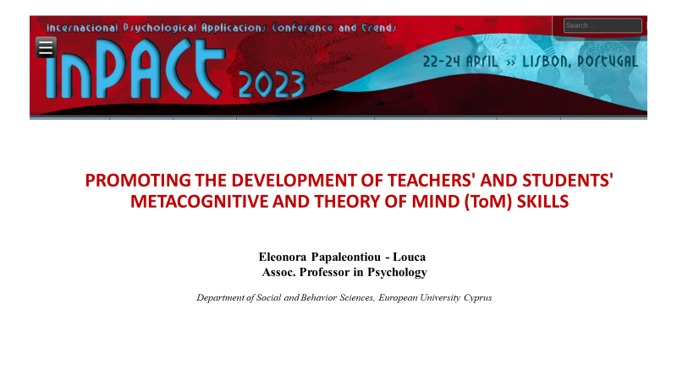
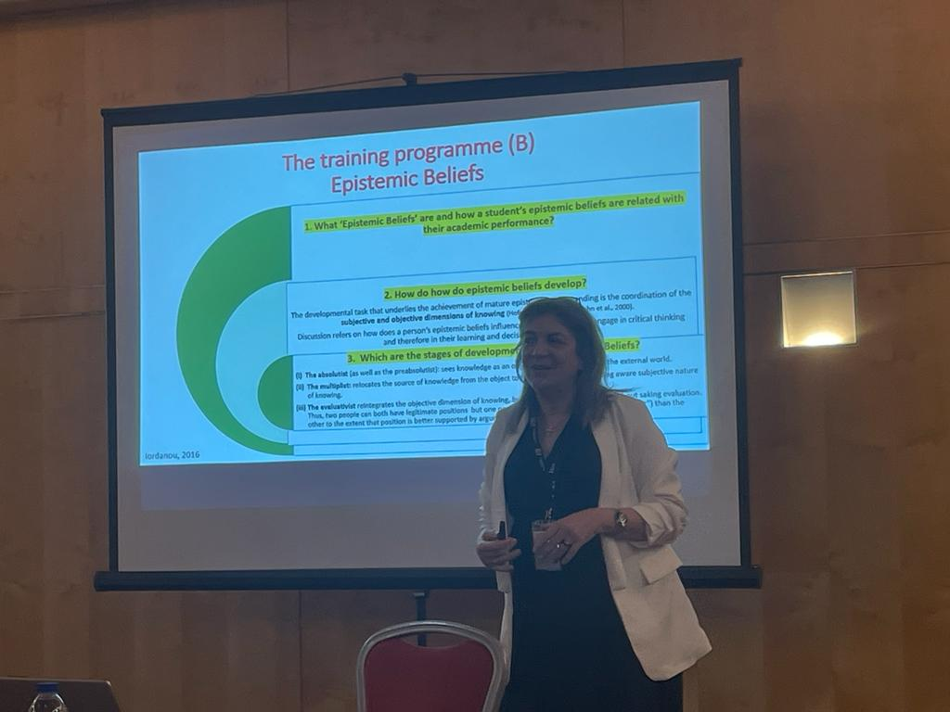
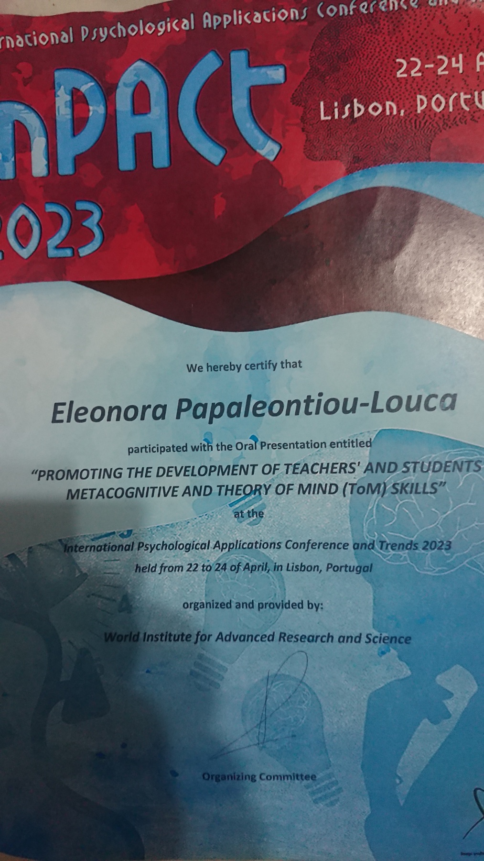
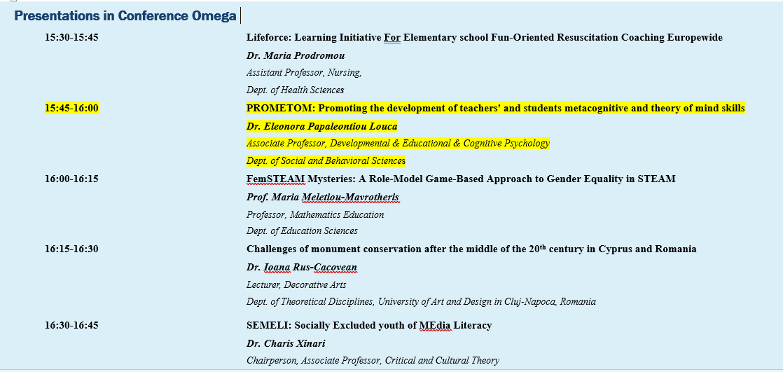
Pro-Me-ToM Project
CONFERENCES / SEMINARS
2. RESEARCH DAY
PRESENTATION, EUC,
9-5-23
1. InPACT 2023
International Conference
Lisbon, April 2023

Slide 19
Pro-Me-ToM Project
INTERVENTION-Program Presentations (a)

Slide 20
Pro-Me-ToM Project
INTERVENTION-Program Presentations (b)

Slide 21
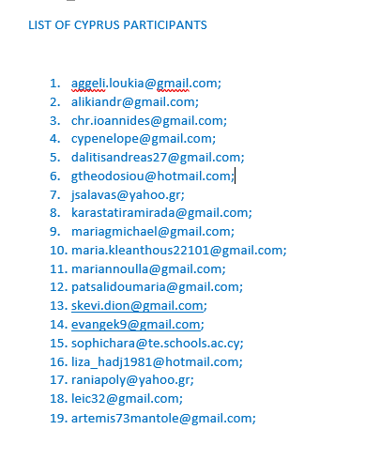
P
Pro-Me-ToM Project
Participants:
About 100 from Greece
About 20 from Cyprus

Slide 22
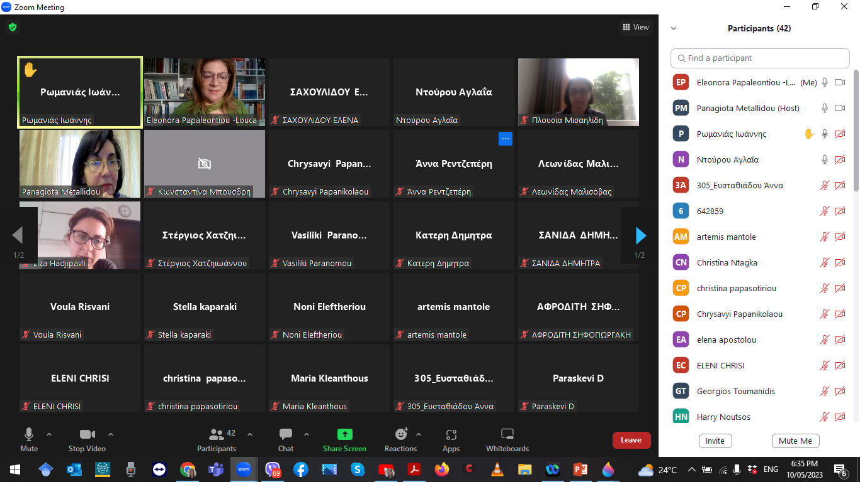
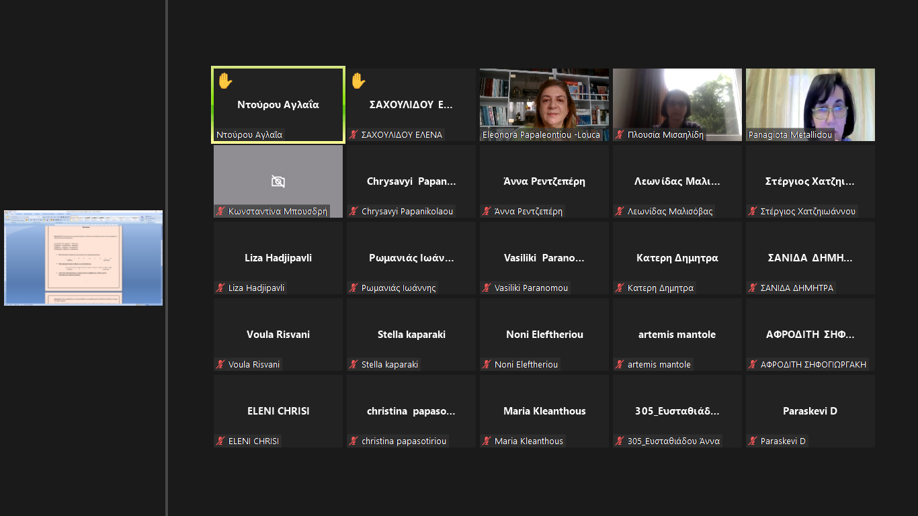
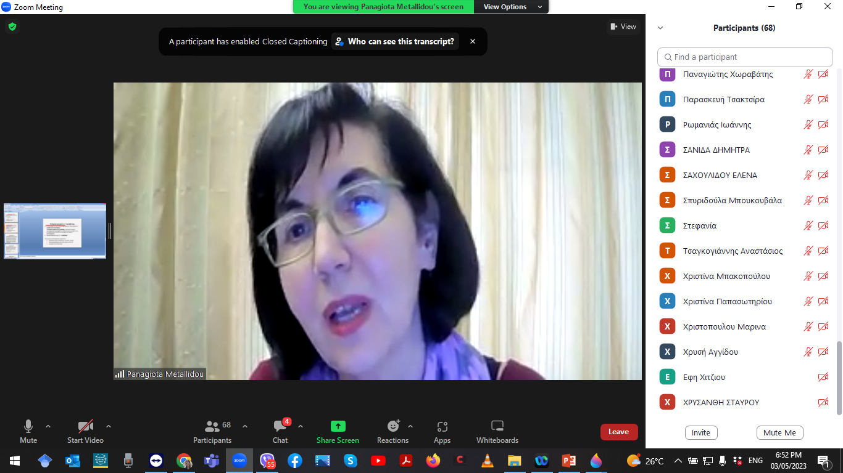
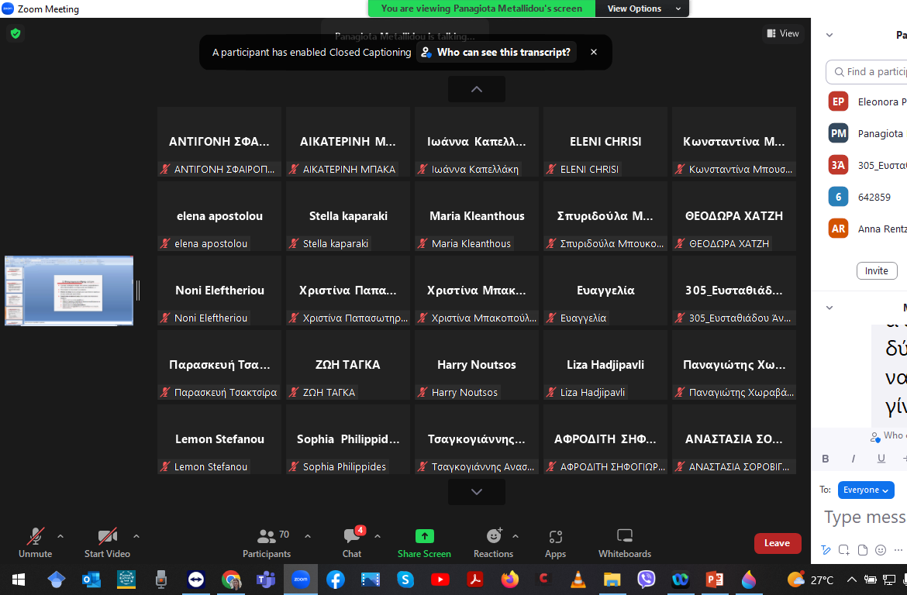
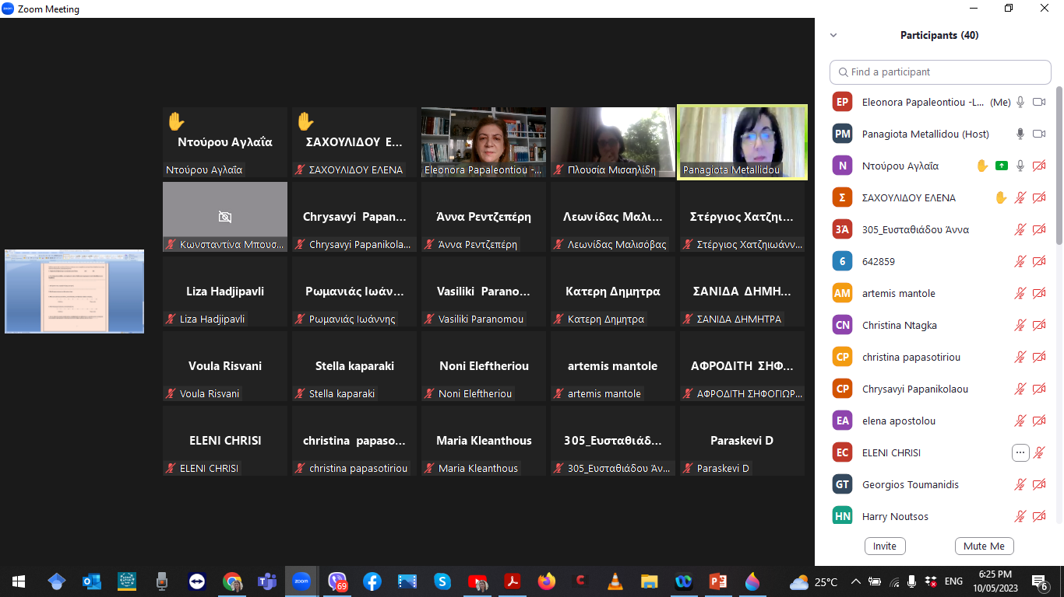
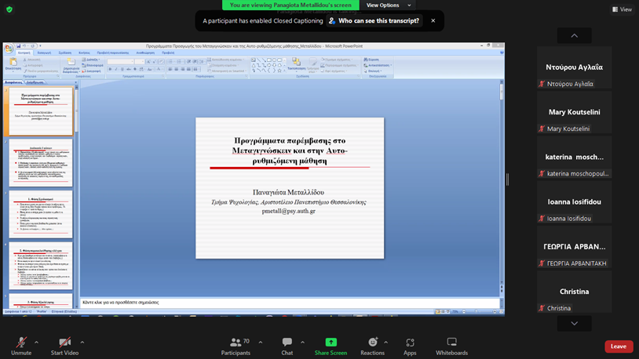
Pro-Me-ToM Project
12 ΟΝ-LINE MEETINGS (print-screens)

Slide 23
Pro-Me-ToM Project
ARTICLES TO BE PUBLISHED
PROMOTING THE DEVELOPMENT OF TEACHERS' AND STUDENTS’
METACOGNITIVE AND THEORY OF MIND (ToM) SKILLS
(InPact Conference Proceedings published and
are under Review in Science Press-Scopus Chapter)
2. Greek group Article on our Intervention-
to be submitted by the end of September 2023)
3. Final Article (with ALL partners’ names) to be submitted in Summer 2024
4. International Articles can be submitted – Pro-Me-ToM to be mentioned

Slide 24
Pro-Me-ToM Project
SAMPLE OF FEEDBACK FROM PARTICIPANT TEACHERS
“I thank you very much for the valuable
knowledge I gained!
It was really one of the most useful
seminars I attended!”
Σ.Δ.

Slide 25
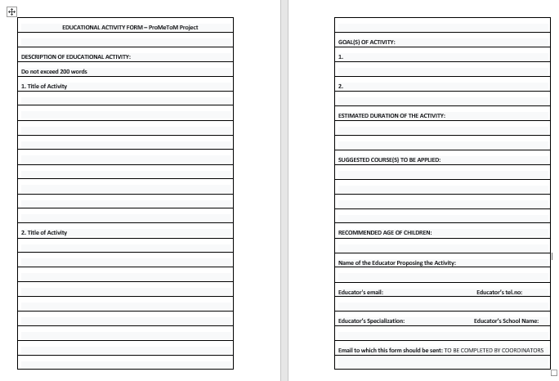
Pro-Me-ToM Project
Teachers’ Proposed Activities

Slide 26
Pro-Me-ToM Project
Teachers’ Proposed Activities
ε
“Students read a text with the title: "Justinian reforms administration and legislation", History
in Byzantine Times (p. 42,43). They follow the course indicated on the attached worksheet.
First they number the measures taken by Justinian, evaluate their importance, select the most
important one. They judge and argue for their opinion. Finally, they distinguish between the measures that were unavoidably necessary and those that he would not have
implemented in order to avoid the Stasis of Nicaea. In this case too,
they judge and argue their point of view. For each of the activities students fill in a difficulty grade before and after the activity.
On a personal level when conducting the activities the students discuss
with the teacher the choice of the difficulty level and report on ways to better manage the task .
At the end of the activities in the whole class discuss their answers, document their choices. At the same time, an attempt is made to understand
the rationale behind a student's choice by another classmate.
e.g. I believe that my classmate chose this measure as the most important because...”

Slide 27
Pro-Me-ToM Project
Teachers’ Reflection Diaries
A Sample
The students began to reflect and critically position themselves for each scenario they were given. They became more observant and paid more attention to things that they previously considered as unnecessary details. There was also a change in their attitudes and in their relationships with each other. They were puzzled and put themselves in the other person's shoes to think about the reasons that made them act the way they did.
At the same time they were able to express their feelings, to justify their actions and in terms of learning, they felt more able to express the way they thought to arrive at an outcome.
The difference was evident compared to the original questionnaire. To a large extent, students applied metacognitive skills cultivated during the year.

Slide 28
Pro-Me-ToM Project
Certificates of Attendance

Slide 29
Pro-Me-ToM Project
What Needs to be done??
 | TASK TO BE DONE | TILL WHEN?
1. | Local Webpages? | end of September 2024
2. | Statistical Analyses of the Phase A Questionnaires (Teachers and Students) | Data Collection - December 2023
3. | Receiving the Data | end of December 2023
4. | Recruitment of new Pool of teachers (primary/secondary – Language /Science) | end of September 2024
5. | INTERVENTION (12 sessions) – PHASE B ( Fall 2023) | October or November 2023
6. | Pre-_ & Post –Tests (Phase B ) | 10th of December 2023
7. | Teachers’ Activities (to be collected – Phase B) | 10th of December 2023
8. | New Diaries’ Reflection (to be collected – Phase B) | 10th of December 2023
9. | Diaries’ Qualitative Analysis – Phase A | ???
10. | Conference Presentation (at least one by each partner) | until July 2024
11 | Radio and/or TV Presentation of the Program (at least one at each country) | until May 2024
11. | Booklet with Teachers’ Activities (in National Language?) to be prepared | July 2024
12. | Final Conference in Thessalonica | June 2024
13. | Final Article to be written on . The Results of our Intervention Program for students and teachers (with the names of ALL partners) | July 2024
14. 15. | Follow-up Assessments of students Follow-up for Teachers | April 2024

Slide 30
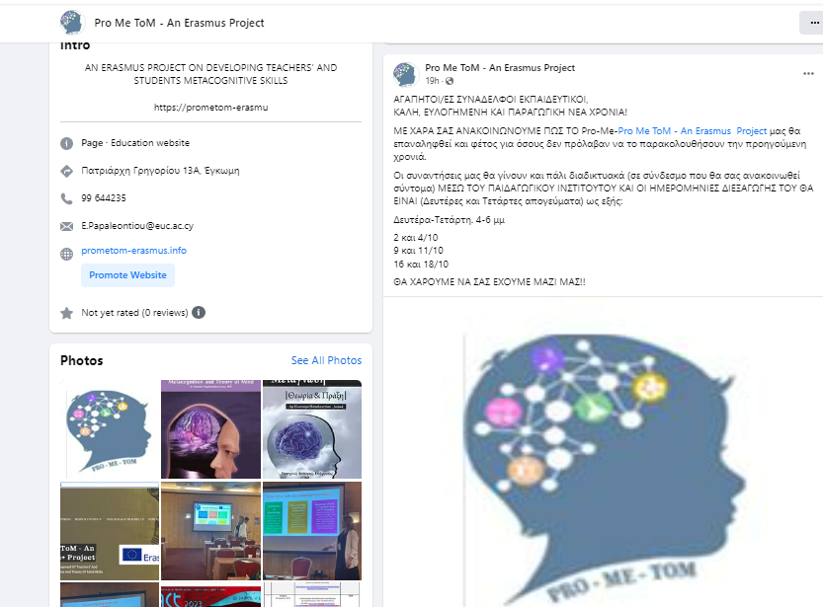
Η δασκάλα/ καθηγήτρια σάς έχε
Pro-Me-ToM Project
NEW CALL F2023
TRAINING PROGRAM
PHASE B
OCTOBER 2023
Mondays and Wednesdays, 4-6 p.m.
2 και 4/10 /23
9 και 11/10/23
16 και 18/10/23
FACILITATOR: PEDAGOGICAL INSTITUTE CYPRUS
Δευτέ
Δευτέρα-Τετάρτη. 4-6μ.μ.
2 και 4/10
9 και 11/10
16 και 18/10
ΘΑ ΧΑΡΟΥΜΕ ΝΑ ΣΑΣ ΕΧΟΥΜΕ ΜΑΖΙ ΜΑΣ!!

Slide 31
Pro-Me-ToM Project
Topics to be discussed
TWO ACTIVITIES BY EACH PARTNER – End of September
NEW DEADLINES
ANNOUNCEMENT OF NEW CALL – SEND INVITATION TO YIANNIS and ELEONORA
BOOKLET (Type / Language / Deadline)
DISCUSS Validity & Reliability Check of Final Tests
CHANGES IN TIMETABLE?
TIMESHEETS AND OTHER QUESTIONS
IN JANUARY we CAN VOTE FOR ANOTHER MEETING IF NEEDED
PRESENTATIONS TO BE SENT – ELEONORA & YIANNIS

Slide 32
Pro-Me-ToM Project
Thanks a lot Coimbra University and Maria de Piedade!

Slide 33
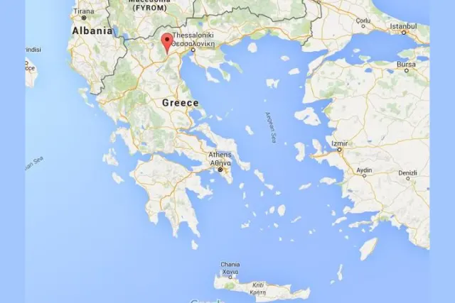
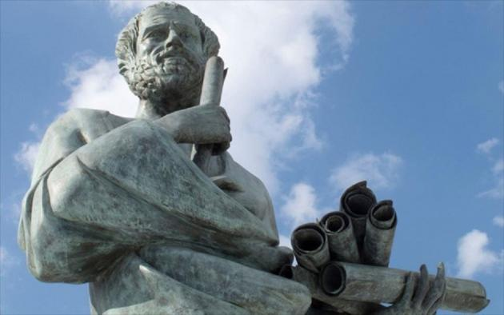
P
Pro-Me-ToM Project
Final Meeting / CONFERENCE!
Aristotle University! June 2024
lot Pecs University!
:

